Slide 1

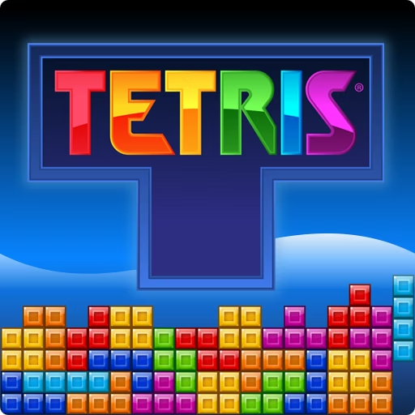

Tetris AI Genetic Algorithm Project
What if a computer could learn to play Tetris—not by being told the rules, but by evolving its own strategy through trial and error, just like nature evolves life?
In this project, we challenged an AI to master one of the world’s most iconic games using nothing but the principles of evolution. No pre-written tactics. No neural networks. Just raw survival-of-the-fittest logic.
Join us as we explore how a Genetic Algorithm transformed random guesses into intelligent moves—and turned chaos into high scores.
by Moaz Gehad

Slide 2


Genetic Algorithm Configuration
Number of GENERATIONS
10
POPULATION_SIZE
12
MUTATION_RATE
0.1
Random Seed
42
Crossover
Split at random point
This setup controls the evolutionary process of the AI, balancing exploration and exploitation to improve Tetris performance over multiple iterations.

Slide 3

Contribution Factors Explained
Max Height
Height of the tallest column on the board.
Removed Lines
Number of lines cleared after placing a piece.
New Holes
Holes created by the latest piece placement.
Piece & Floor Sides
Number of sides of the piece touching other blocks or the floor.

Slide 4

Additional Contribution Factors
Wall Sides
Total Holes
Total Blocking Blocks
Sides of the piece touching the wall.
Empty cells with filled cells above them on the board.
Blocks sitting above holes, potentially blocking line clears.

Slide 5

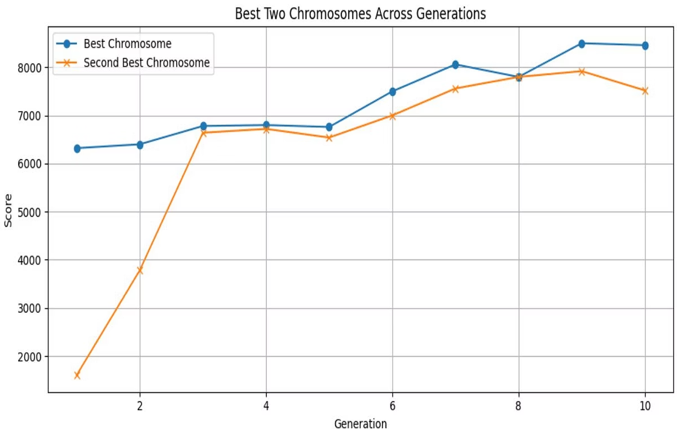
Evolution of Top Chromosomes Over Generations
The genetic algorithm's top chromosomes improved their scores steadily from generation 0 to 9. The best chromosome started with a score of 6320 and reached up to 8500 by generation 8. This progression demonstrates the effectiveness of evolutionary optimization in enhancing Tetris AI performance.

Slide 6

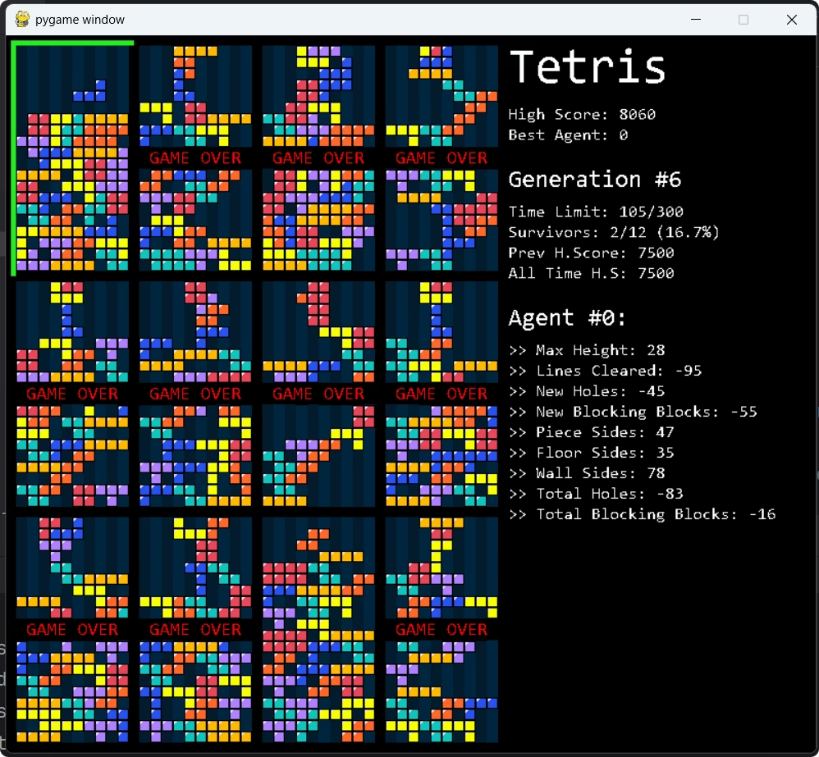
Top Chromosome Scores and Variations
Chromosome Example
Score Progression
Scores ranged from 6320 at generation 0 to 8500 at generation 8, showing steady improvement.
One top chromosome's gene sequence: [28, -95, -45, -55, 47, 35, 78, -83, -16]
This chromosome consistently achieved high scores across generations.
Variations in gene values contributed to performance differences.

Slide 7

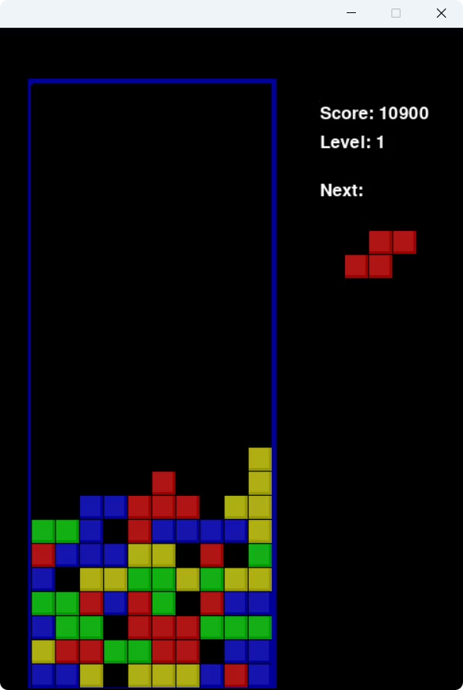
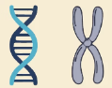
Test Chromosome
We tested the top scoring chromosome for 600 iterations to check if it wins or not
Chromosome: [-54, -80, -45, -55, 47, 35, 78, -83, -16]
Score after 600 iterations : 11460
Status : Win

Slide 8




Genetic Algorithm Impact on Gameplay
Optimized Piece Placement
Adaptive Strategy
Mutation and selection refine strategies over generations for better scores.
AI uses evolved chromosomes to minimize holes and maximize line clears.
Balance of Factors
Contribution factors guide AI to balance height, holes, and block contacts.

Slide 9


Summary and Future Directions
The genetic algorithm successfully improved Tetris AI performance by evolving chromosomes over 10 generations. Key contribution factors were effectively balanced to optimize gameplay. Future work could explore larger populations, more generations, or additional factors to further enhance AI capabilities.
This approach demonstrates the power of evolutionary algorithms in complex game strategy optimization.

Slide 10



Team
GA Tetris Task Contributers
Moaz Gehad
20220340
Abdelrahman Ibrahim
20220519
Mahmoud Ehab Helmy
20220457
ACO - TSP Task Contributers
Rana Esmail Zekery
20220131
Menna Tullah Hany
20220343
Nadine Hazem
20220356
Github Repository

